Slide 1
What is ‘Critical’ in Critical AI and Education Research?
Jeremy Knox

Slide 2
Education is being impacted by ‘AI’ on four key fronts: ideologically; epistemologically; sociologically; and politically
Promises and imaginaries
Knowledge and expertise
of enhanced, efficient, and precise futures
of data science and computer engineering
Inclusion and equality
Governance and agency
of access and the distribution of benefits
of institutions, teachers, and students

Slide 3
‘Adaptive’ or ‘personalised’ learning
Over 1 million students
Partnered with 60, 000 schools

Slide 5
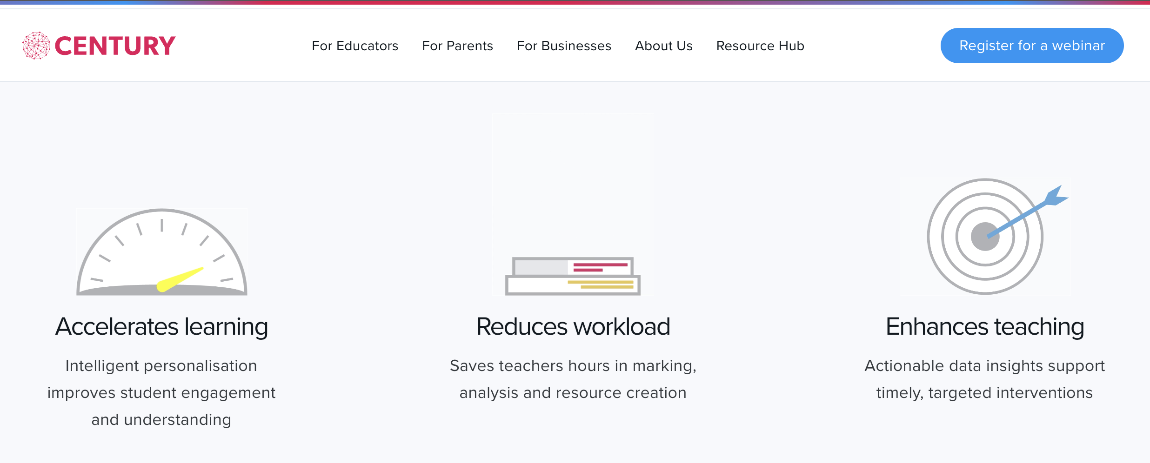
Promises and imaginaries
of ‘adaptive’ or ‘personalised’ learning
Mythology: the widespread belief that large data sets offer a higher form of intelligence and knowledge that can generate insights that were previously impossible, with the aura of truth, objectivity, and accuracy (boyd and Crawford 2012, p663)
Acceleration
Efficiency
Enhancement
boyd, d & Crawford, K. (2012) Critical Questions for Big Data, Information, Communication & Society, 15:5, 662-679
Eynon, R. 2022. The datafication of education: designing for alternative futures: Keynote, Yidan Prize Doctoral Conference.

Slide 6
‘provide each child with a super-power AI teacher that is the combination of Einstein and Socrates, that way it feels like she has more than 100 teachers in front of her’ (Li quoted in van Hooijdonk 2019)

Slide 7
Knowledge and expertise
of data science and computer engineering
We’re trying to seize the latest developments in machine learning and data science to improve education and personalised learning to a level that was just not achievable before

Slide 8
Knowledge and expertise
of data science and computer engineering
valorising of ‘data science’ expertise in education
‘private companies appear to extract value from the conduct of teachers and students engaged in public education’ (Knox 2021, p7)
Knox, J. (2021). Refocusing Zuboff’s ‘division of learning’ on Education. Seminar.net Special Issue: Digital Capitalism, Datafication, and Media Education: Critical Perspectives. 17(2). https://doi.org/10.7577/seminar.4268

Slide 9
‘just about everything we now do is mediated by computers that record and codify the details of our daily lives’ (Zuboff 2019, p182)
‘Big tech’ companies have ‘amassed world-historic concentrations of knowledge and power’ (Zuboff 2019, p179)

Slide 10
‘division of learning’:
‘the axial principle of social order in an information civilisation’ (Zuboff 2019, p179)
‘ascendant principle of social ordering in our time’ (Zuboff 2019, p181)
owners
users
experts (processing and deriving benefits from data)
generators (of data)
subjects (of interventions / behavioural ‘nudging’)
‘shadow text’
user interface

Slide 11
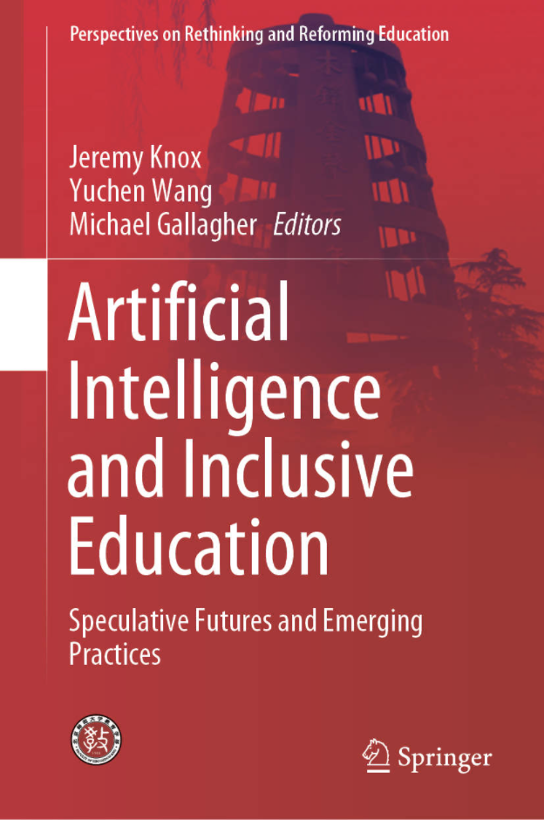
Inclusion and equality
of access and the distribution of benefits
the educational ‘dream’ of ‘everyone learning everything’ (Friesen 2019, p2)
‘an intelligent, personal tutor for every learner’
(Luckin et al. 2016, p24)
‘comprehensive, holistic, ambitious, aspirational and universal, and inspired by a vision of education that transforms the lives of individuals, communities and societies, leaving no one behind.’ (UNESCO 2015, p24)

Slide 12
granularise

Slide 13
diagnose

Slide 14
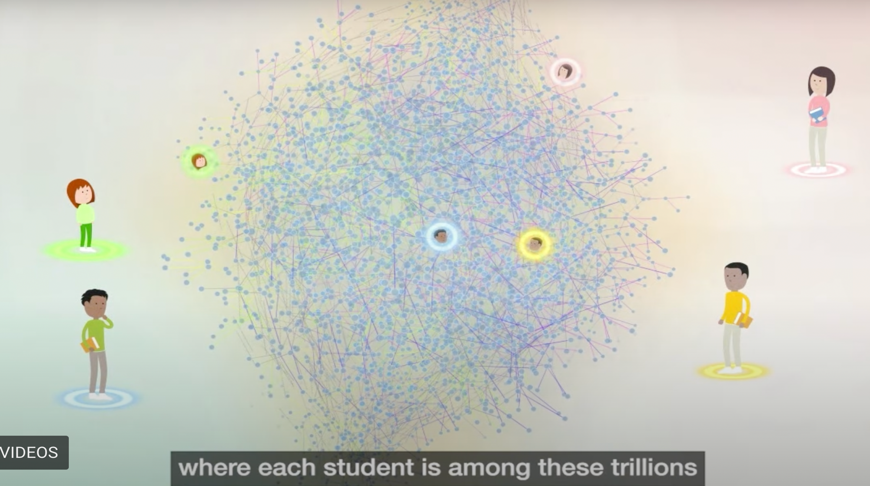
situate and direct

Slide 15
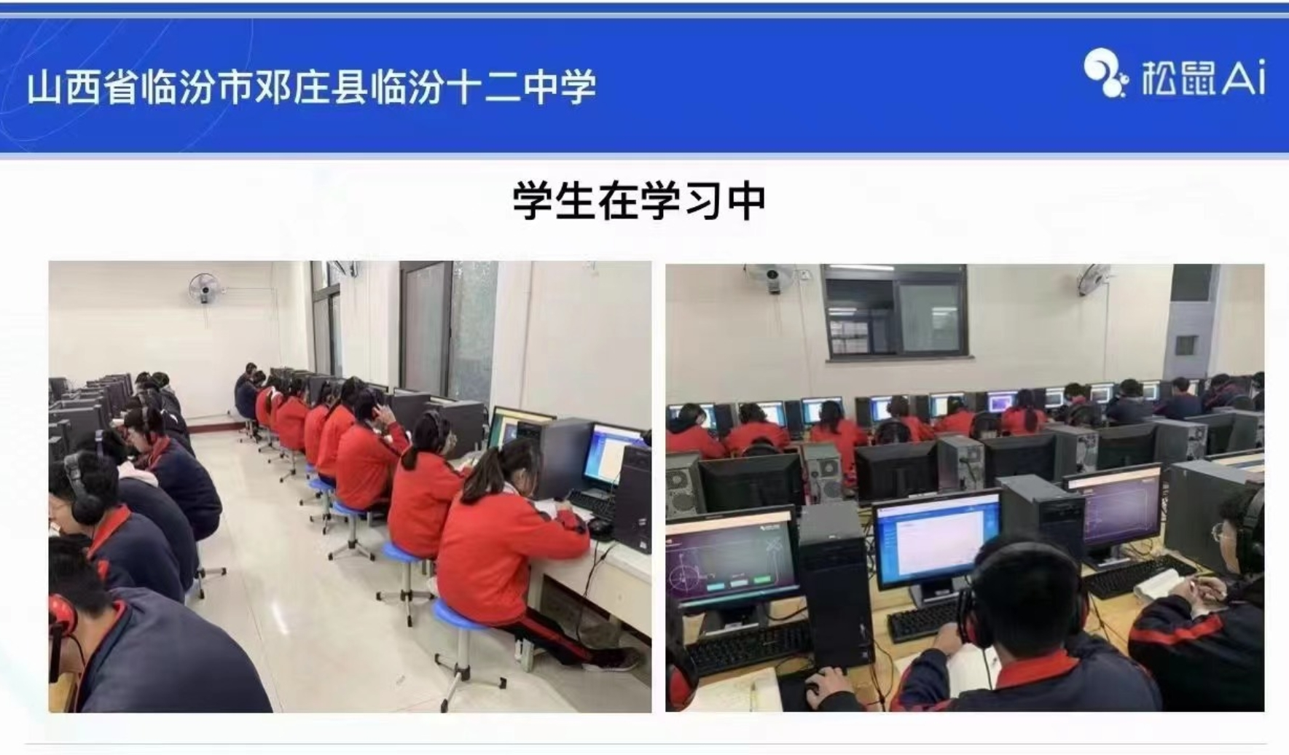
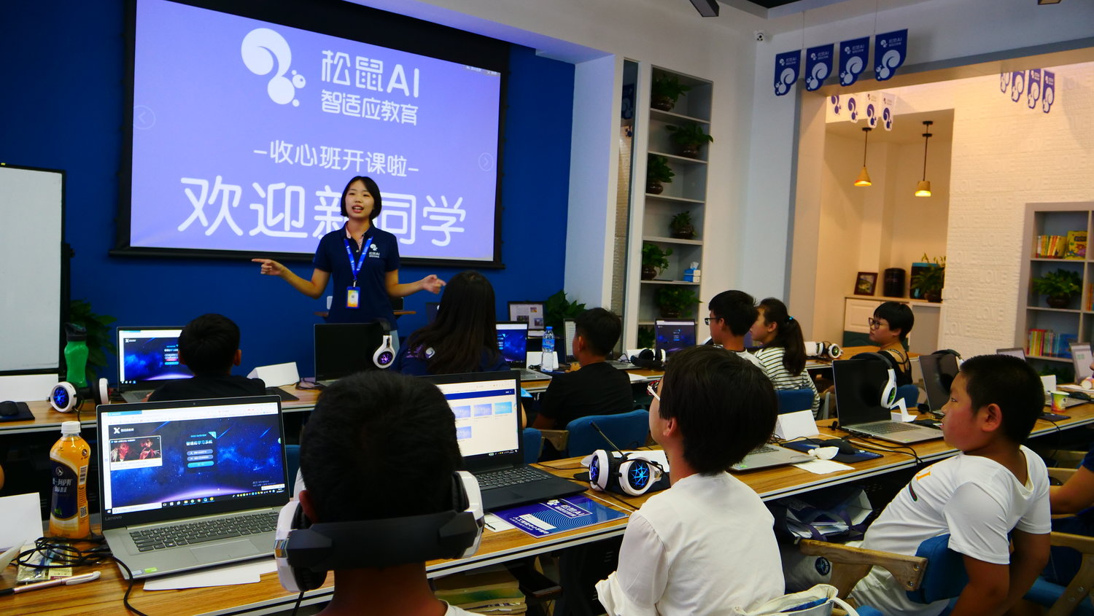
Inclusion and equality
of access and the distribution of benefits
Such technologies often conform to, and even exacerbate, existing inequalities
‘AI and education appear to have coalesced at the pressure points of exam competition, fused along the fault lines of regional inequality’ (Knox 2023, p139)
Knox, J. (2023). AI and Education in China: Imagining the Future, Excavating the Past. Routledge.

Slide 16
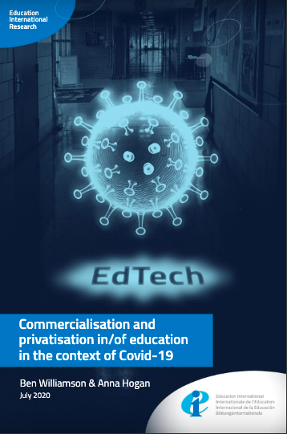
Governance and agency
of institutions, teachers, and students
The analytics, data, and AI systems developed by global technology companies and edtech businesses have become experimental engines of algorithmic education—and school systems have become their laboratories (Williamson 2021,
Williamson. B. 2021. Education Technology Seizes a Pandemic Opening Current History 120 (822): 15–20.

Slide 17
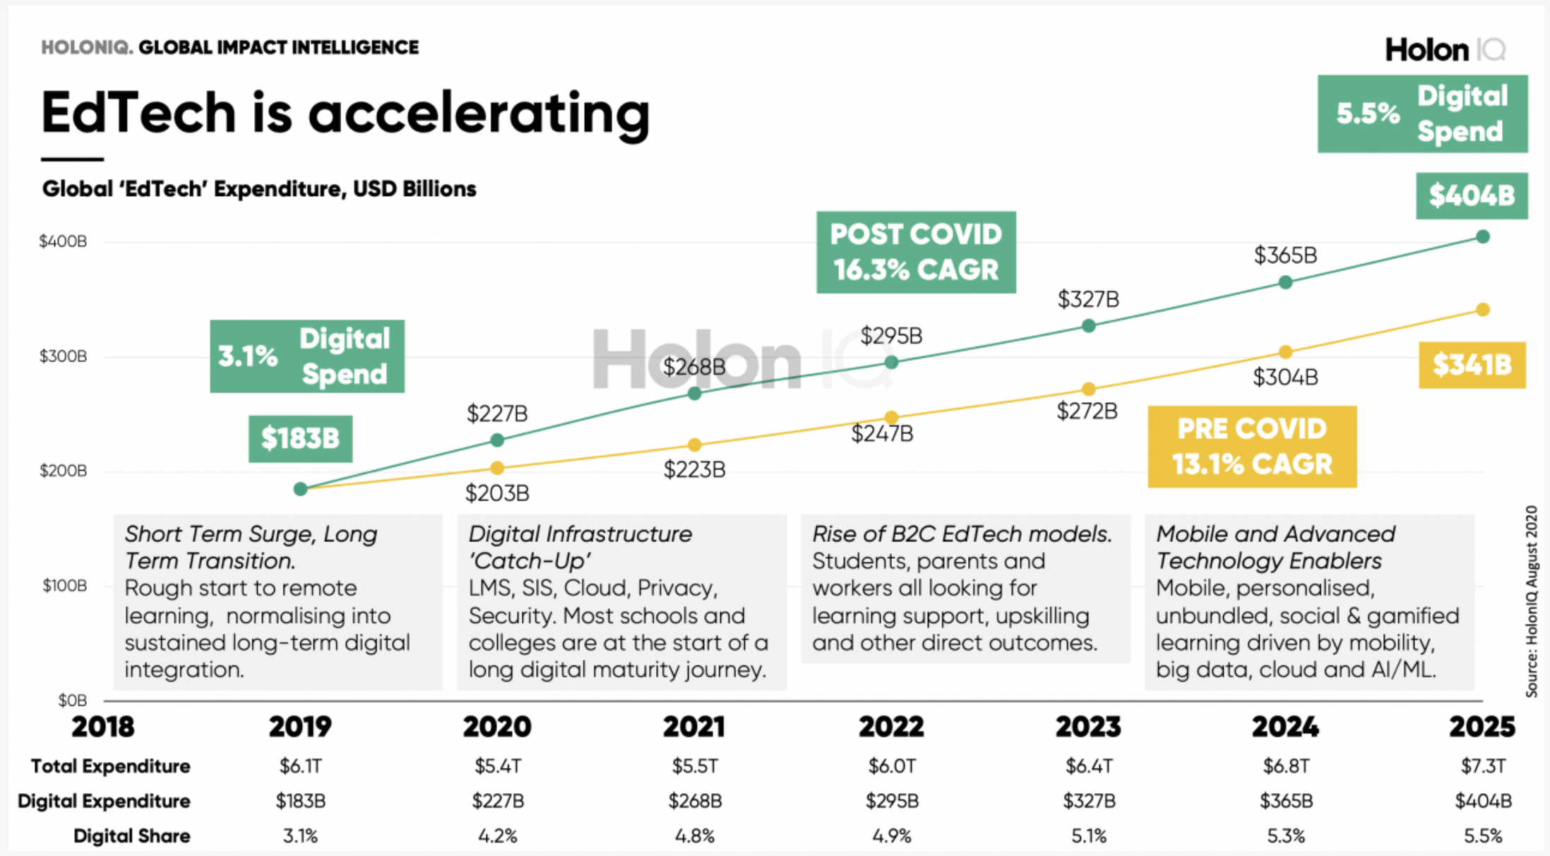

Slide 18
Ensure inclusive stakeholder participation in the ongoing development of ethical understanding and practice at Squirrel AI.
Develop knowledge and practice relating to methods of participatory co-design.
Governance and agency
of institutions, teachers, and students
Knox, J., Yuan, L. and Hoel, T. (2022) Squirrel AI – Ethical Guidelines Report

Slide 19
formal institutional education might therefore adopt a more central role in developing a “data science” with social and emancipatory purpose; one that is foundationally engaged in collective justificatory practices about how and why particular technologies and techniques should be developed, as well as attentive to the kind of individual citizen-subjects produced through such methods. (Knox 2021)
Knox, J. (2022). (Re)politicising data-driven education: from ethical principles to radical participation. Learning, Media and Technology.

Slide 20
Promises and imaginaries
Knowledge and expertise
economic and positivist
replicable teacher
valorising of ‘data science’
‘division of learning’
Inclusion and equality
Governance and agency
personalisation vs inclusion
replication of existing inequalities
private sector
Participatory design / design justice

Slide 21
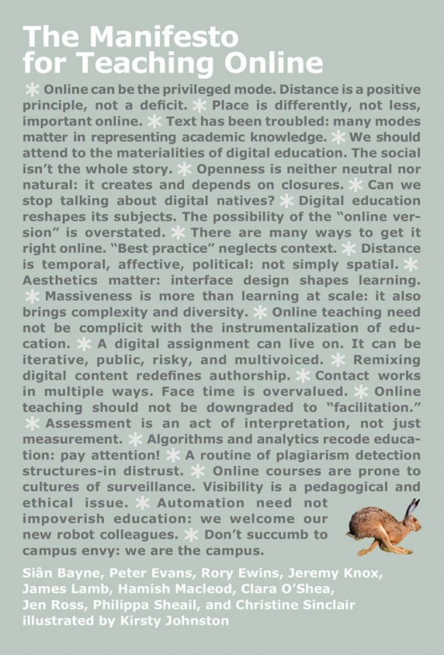
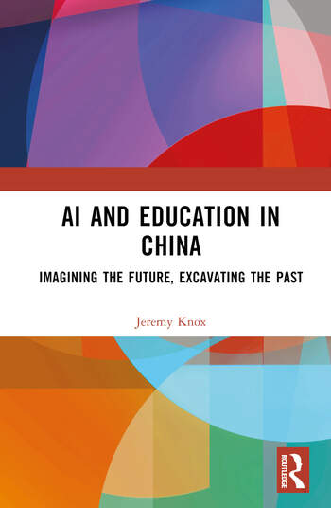
thank you

